Slide 1

Bike Rental Analysis
Mobile Price Prediction Using Machine Learning
Presented by Ashwini Meshram
Presented by Ashwini Meshram

Slide 2
Introduction
• Mobile prices depend on multiple hardware and product characteristics.
• Manual price estimation can be inconsistent when many specifications are involved.
• The project builds a machine learning model that learns pricing patterns from historical mobile data.
• The final system accepts user-provided specifications and returns an estimated mobile price.

Slide 3
Project Objective
• Explore and understand the mobile-phone dataset.
• Clean the data and handle missing or unnecessary fields.
• Identify features that contribute to mobile price.
• Encode categorical specifications for machine learning.
• Build and evaluate a Random Forest regression model.
• Perform feature extraction to identify the most relevant features that strongly affect the price of mobile phones. Use statistical methods, visualizations, or feature importance techniques (e.g., correlation analysis, feature selection, or dimensionality reduction) to narrow down the list of important features. Create a user-input prediction system for estimating mobile price

Slide 4
Tools Used
Python
Pandas
NumPy
Seaborn
Matplotlib
Scikit-learn
OneHotEncoder
RandomForestRegressor
v

Slide 5
Price Distribution – Univariate Finding
The dataset contains 541 mobile-phone records with numerical and categorical variables
Mobile phones in the dataset are available across different storage capacities, with 128 GB and other mid-to-high storage configurations forming an important portion of the dataset. Storage capacity is potentially relevant for price prediction.
The dataset contains phones with different RAM capacities, ranging from entry-level to higher-performance configurations. Higher RAM configurations are common in modern smartphones and may contribute to higher price.
Battery capacity varies considerably across smartphones. However, battery capacity alone does not necessarily indicate a premium phone, so its relationship with price should be evaluated during bivariate analysis.
The mobile-phone price distribution is positively/right skewed. Most phones are concentrated in the low-to-mid price range, while a smaller number of premium smartphones have substantially higher prices.

Slide 6
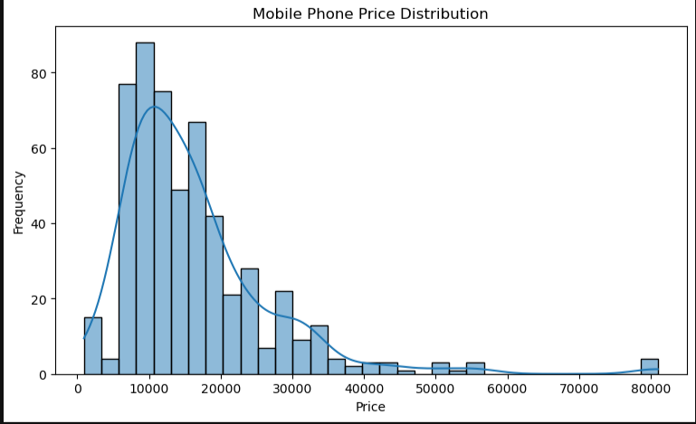
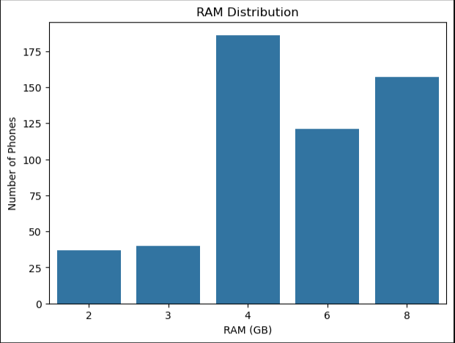
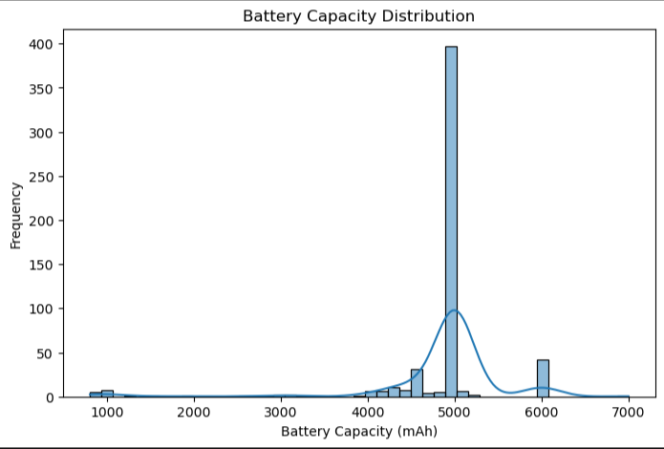
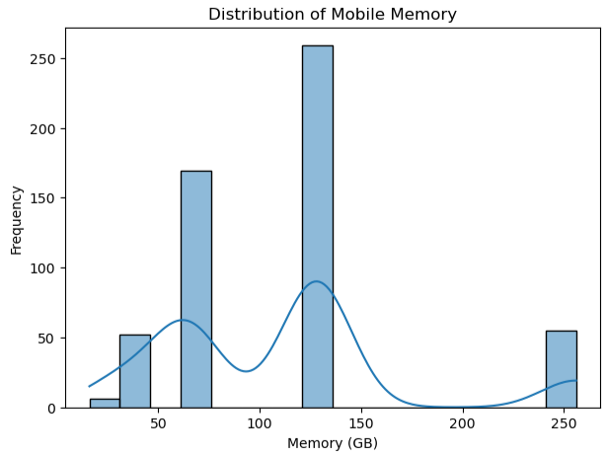

Slide 7
Price Outlier Analysis Using IQR
The detected price outliers are likely to represent genuine premium smartphones rather than erroneous observations. Therefore, they should be retained for the prediction model unless further investigation identifies incorrect records.
Q1: 9290.0
Q3: 19280.0
IQR: 9990.0
Lower Limit: -5695.0
Upper Limit: 34265.0
Number of Outliers: 25

Slide 8
Model Categorical Univariate Analysis
The dataset contains 187 unique mobile models, indicating substantial model diversity. Because of this high cardinality, directly one-hot encoding every model may create a large number of features.
The colour variable has very high cardinality, with 275 unique values. A small number of colour categories occur frequently while many colours occur only once or a few times. Therefore, colour may require grouping or careful encoding during feature engineering.
Rear-camera specifications vary across the phones. Converting the camera specification into megapixels creates a useful numerical feature that can later be evaluated for its effect on price
Front-camera specifications show variation across mobile phones. Extracting the megapixel value converts the original text feature into a numerical variable suitable for statistical analysis and machine learning
The dataset contains a wide variety of processors. Processor is potentially an important feature for price prediction, but its high cardinality means that direct one-hot encoding could produce many columns.

Slide 9
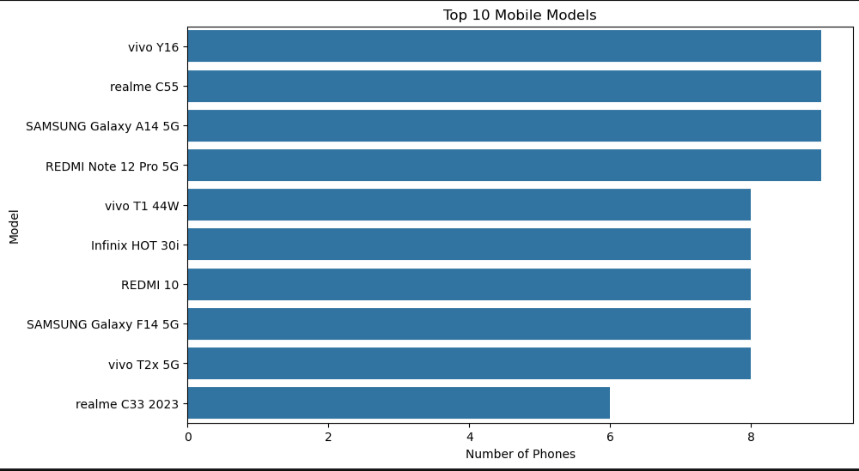
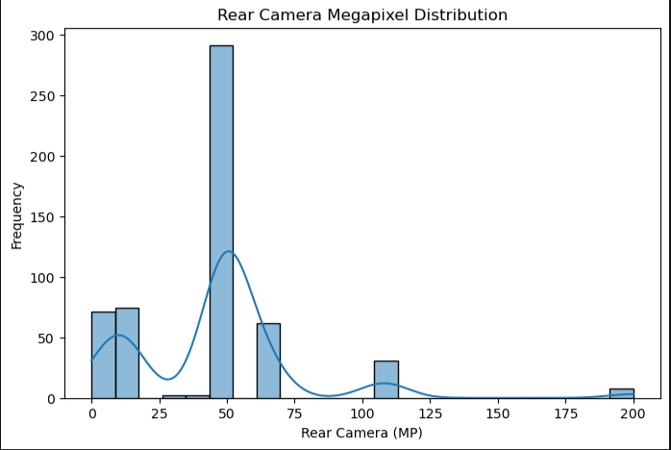
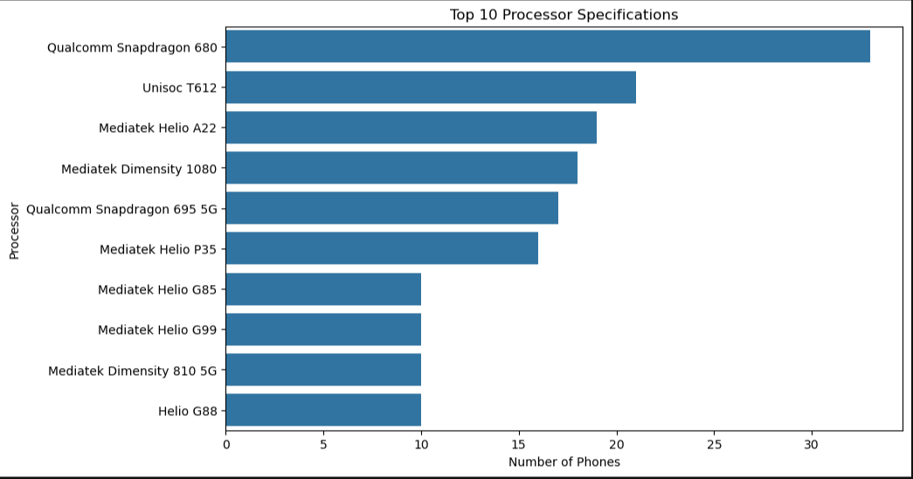
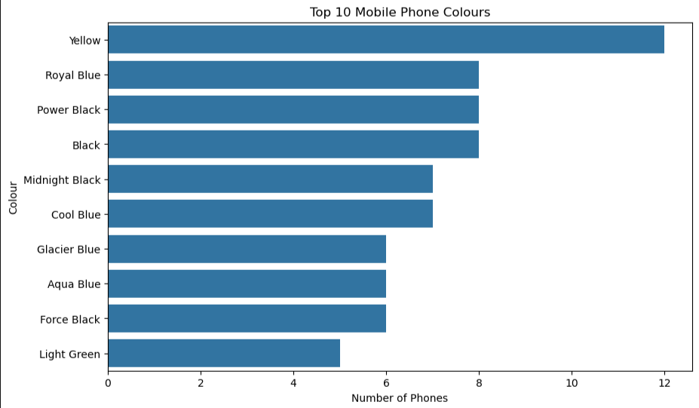

Slide 10
Feature Extraction and correlation
Feature extraction was performed using correlation analysis and Random Forest feature importance. Memory and RAM showed the strongest relationship with mobile phone price.
Mobile Height and camera specifications had comparatively lower influence, while Battery Capacity showed very weak linear correlation with price. Therefore, Memory and RAM were identified as the most relevant numerical features for price prediction.
Categorical features such as Model and Processor can also contribute significantly and should be encoded appropriately before model training.
Memory and RAM are the strongest numerical features affecting mobile price

Slide 11
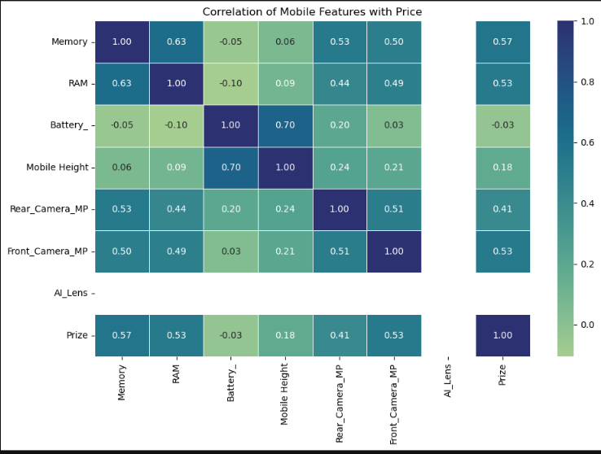
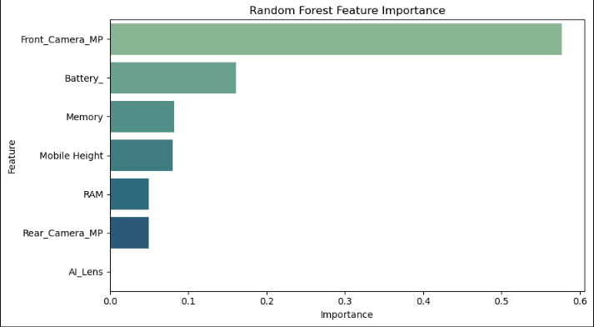
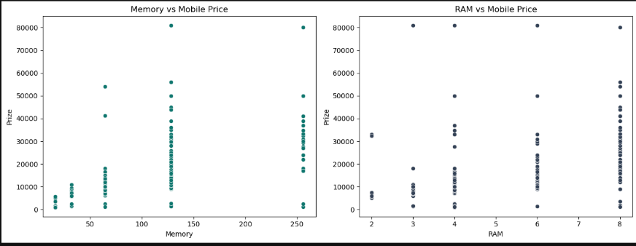

Slide 12
Bivariate Analysis- Findings
Phones with higher memory/storage generally have higher prices.
Memory showed one of the strongest positive relationships with Prize.
This makes memory an important feature for price prediction.
Phones with higher RAM generally have higher prices.
Average price varies across battery capacities, but the relationship is relatively weak.
Higher camera specifications can be associated with higher-priced phones, but camera megapixels are not the only factor.
Front camera has a relatively weaker relationship with price.
Premium phones may have better front cameras, but other features contribute more strongly to price
Phones with and without AI Lens have different price distributions.
However, AI Lens has a much weaker relationship with price than Memory and RAM.
Different processors show different price distributions.
Premium processors are generally associated with higher-priced phones.
Processor is likely an important categorical feature for the prediction model.

Slide 13
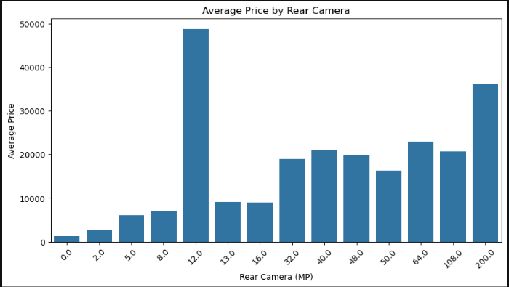
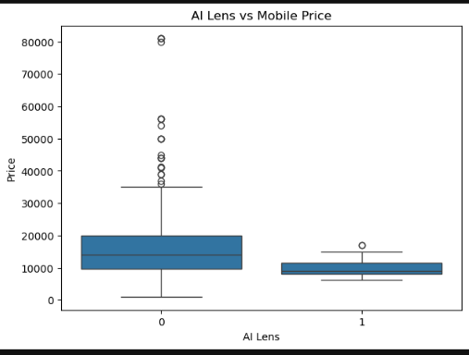
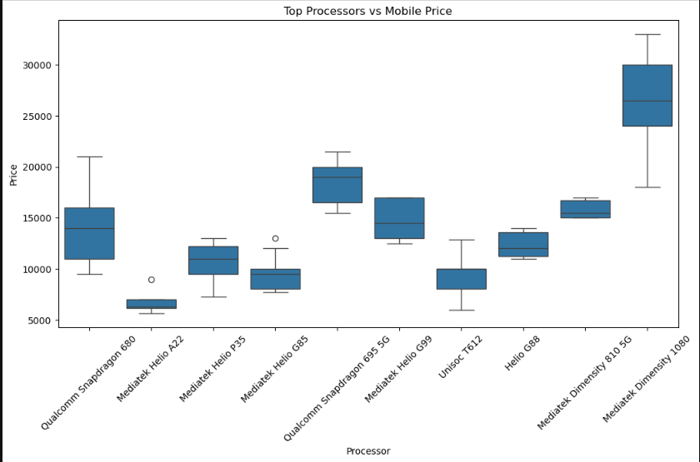
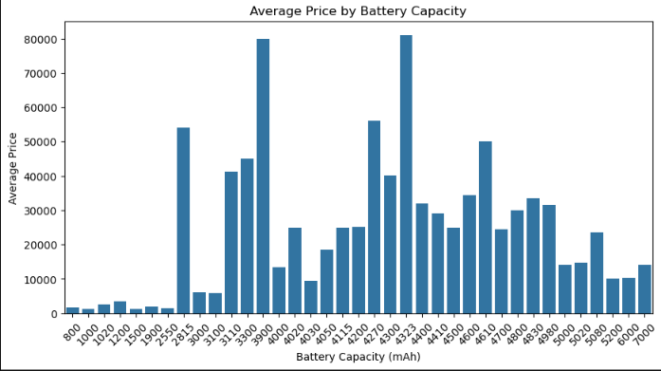

Slide 14
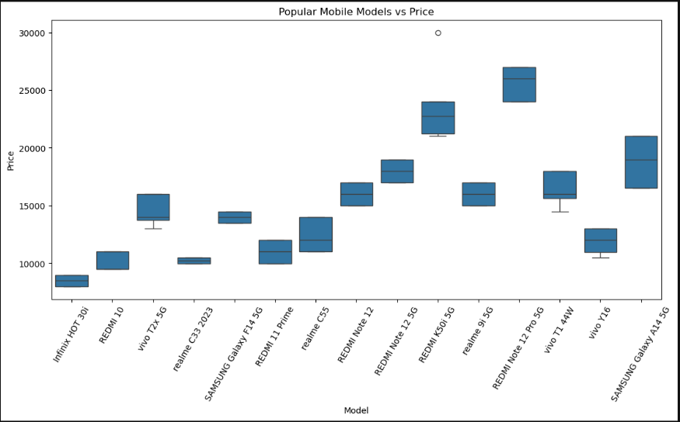
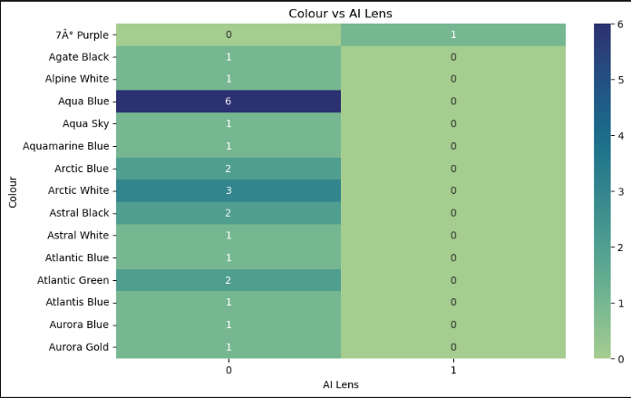
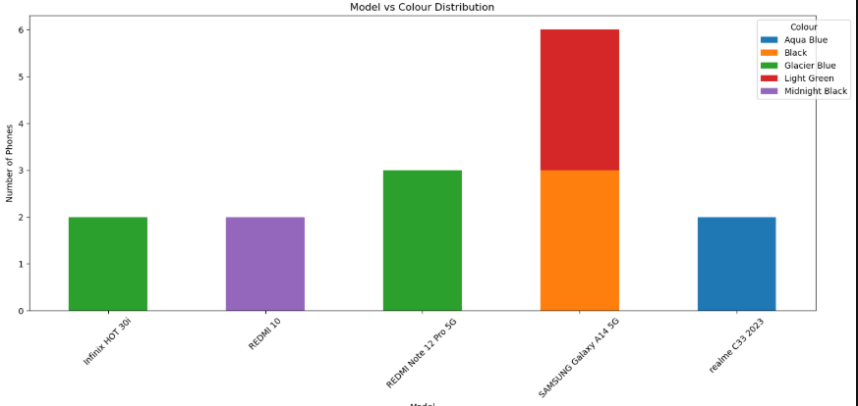
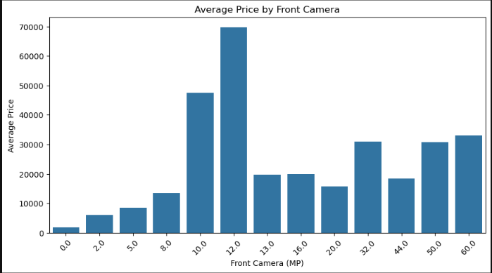

Slide 15
Multivariate Analysis Findings
Price generally increases with higher Memory and RAM. High-memory phones with higher RAM tend to belong to premium price ranges. This confirms that Memory and RAM together are important price-related features.
Phones with similar memory can have different prices depending on the processor. Processor therefore provides additional information beyond storage. Premium processors generally appear in higher-priced configurations.
Phones with higher RAM generally have higher prices, while AI Lens provides an additional but weaker distinction between price groups.
Price differences are influenced by the combination of processor and RAM. Higher RAM configurations within stronger processor categories tend to command higher prices.
Different models have different price ranges even when RAM is similar. This indicates that model/brand-related information captures additional pricing factors. RAM alone cannot completely explain the price
Phones combining higher RAM and better rear-camera specifications tend to occupy higher price ranges.

Slide 16
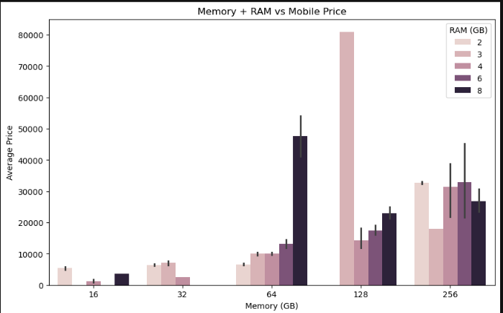
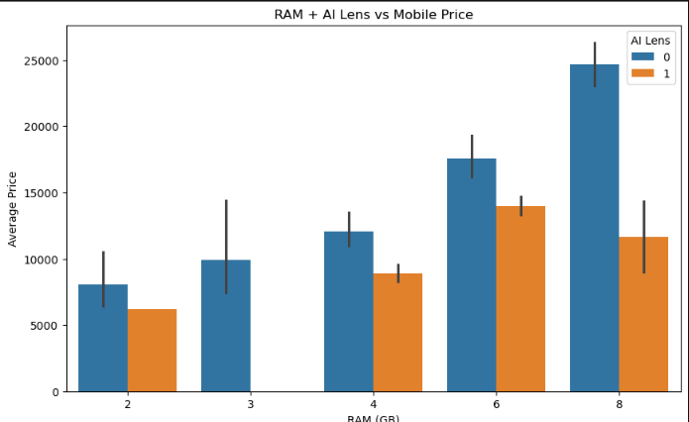
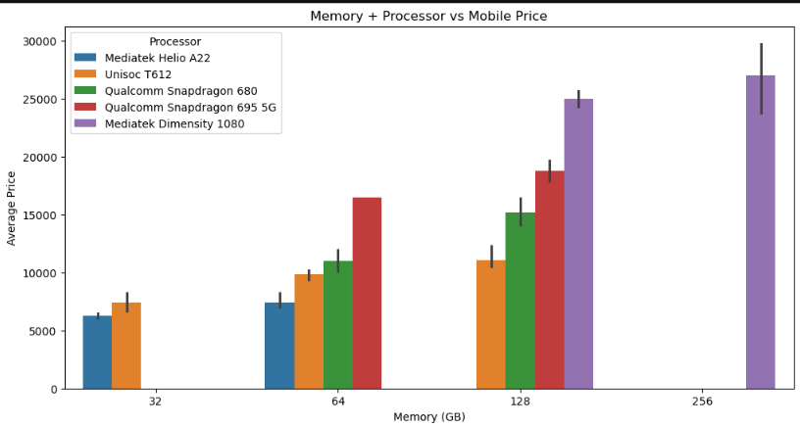
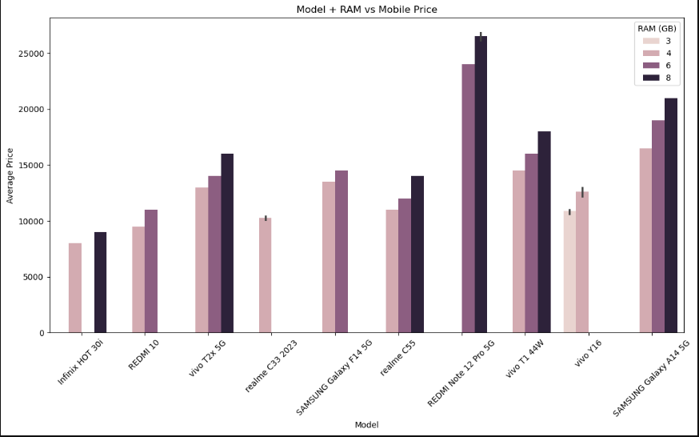

Slide 17
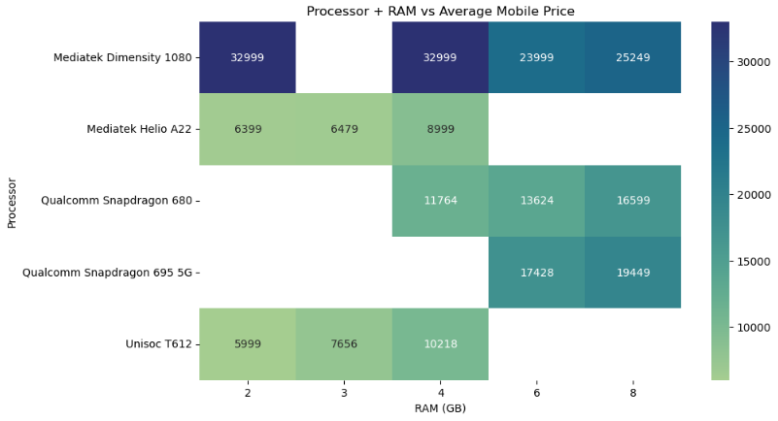
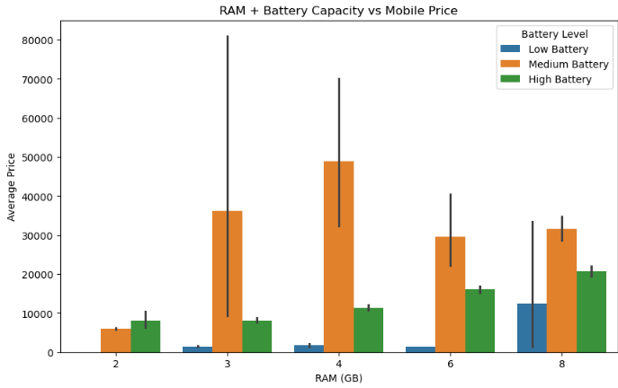
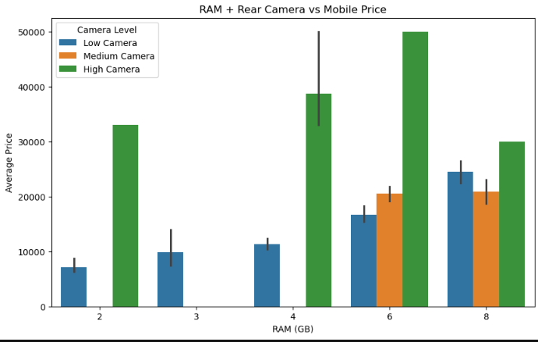
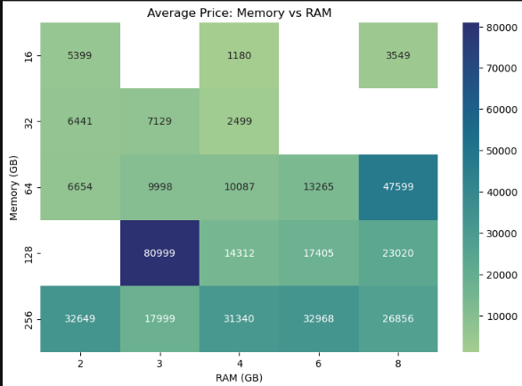

Slide 18
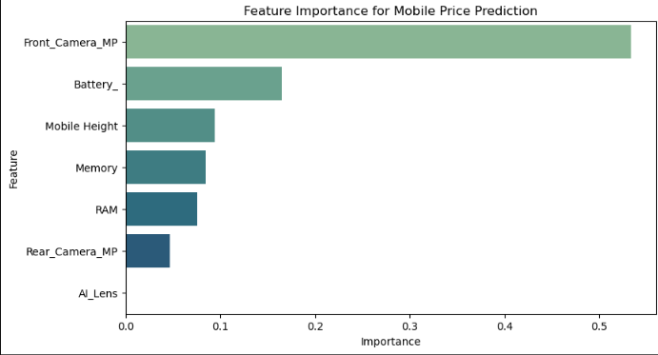
Multivariate analysis shows that mobile phone price is influenced by a combination of hardware specifications rather than a single feature. Memory and RAM have the strongest numerical relationships with price. Processor and model provide additional differentiation between price groups, while camera specifications contribute moderately. Battery capacity and mobile height have comparatively weaker effects. Overall, the combination of Memory, RAM, Processor, Model, and camera-related features provides the most useful information for mobile price prediction.

Slide 19
User Input Prediction System
• The Tkinter interface collects mobile specifications from the user.
• Inputs include model, colour, memory, RAM, battery, camera, AI Lens, height and processor.
• The same preprocessing pipeline used during training transforms the input.
• The trained Random Forest model predicts the estimated price.
• The result is displayed directly in the application.
User Input
Preprocessing
Random Forest
Predicted Price

Slide 20
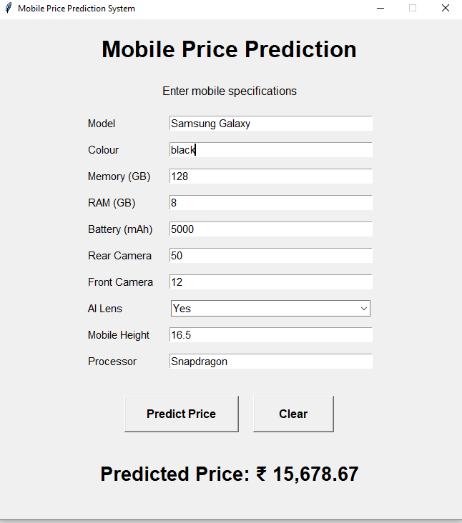
• Example Model: Samsung Galaxy
• Memory: 128 GB | RAM: 8 GB
• Battery: 5000 mAh
• Rear Camera: 50 MP | Front Camera: 12 MP
• AI Lens: Yes | Mobile Height: 16.5
• Processor: Snapdragon
₹15,678.67
Predicted Price
• This is an example generated by the trained model.
• The predicted value depends on the patterns learned from the dataset.
• Changing the specifications can change the predicted price.

Slide 21
Final Conclusion:
The Random Forest model successfully learns the relationship between mobile specifications and price.
Memory, RAM, processor, model, and camera specifications are important factors in determining mobile prices.
The model can predict the estimated price of a new mobile phone based on user-provided specifications, making it useful for pricing strategy and product planning

Slide 22
Business Recommendations
• Use storage and RAM combinations when designing different price tiers.
• Use processor and model information to position premium products.
• Consider camera capabilities as an additional pricing differentiator.
• Use the prediction system as an initial pricing-support tool before market launch.
• Retrain the model periodically with new market prices and newly released phone specifications.
• Add more recent products and market factors to improve future prediction accuracy.

Slide 23
Thank you

